Slide 1
The Growth of Industrialism
State Standards 6.1, 6.2, 6.3, 6.7, 6.8, 6.9, and 6.12

Slide 2
Industrial Revolution
Civil War’s Impact
Aspects of the Civil War’s modern warfare led to the growth of industrialism in the United States
Inventions
New machines and processes increased production
Stimulated development in transportation, communication, farming, ranching, and mining

Slide 3
Farms to Factories
Rural Farm Areas
Before the Industrial Revolution the United States was predominately rural
30 million people in US, 1.3 million worked in industry
Agrarian
Society based on agriculture
Industrial Revolution leads to factories being developed in urban areas (cities)
Rural farm workers would move to cities to gain jobs in these factories

Slide 4
Farm to Factories.
Mass Production
Utilized an assembly line in which each worker repeated the same task which helped increase production

Slide 5
East to West
Railroad
People began moving West by way of the railroad
As more railroads were built their became more need for mining coal
This is because coal powered the steam engine
Gold Discovered in 1848
Hopeful miners move West
Leads to the establishment of boom towns all along the way to supply the miners

Slide 6
Transcontinental Railroad
1862
Congress passes the Pacific Railway Act
Allows the Central Pacific Railroad to lay track eastward from Sacramento, California
Allows the Union Pacific Railroad to lay track west from Omaha, Nebraska
Railroads granted federal lands to sell as an incentive
This land sold by railroad companies to settlers for a profit

Slide 7
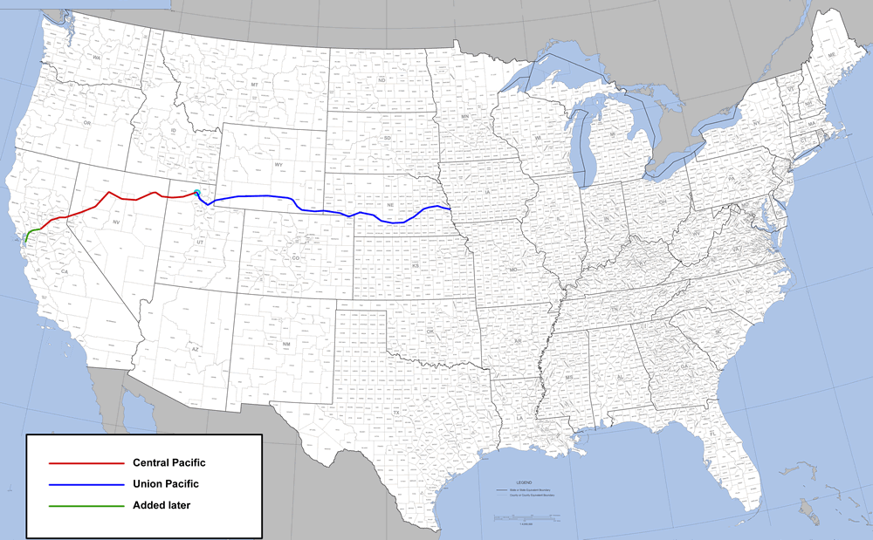

Slide 8
Transcontinental Railroad.
Promontory, Utah, May 10, 1869
Transcontinental Railroad completed
Allows goods, cattle, and farm products to crisscross the country
Homestead Act of 1862
Each adult head of household given land if he or she lived on and developed that land for five years
Was used as a way to convince people to settle the West
Barbed Wire
Makes it easier for settlers to contain their cattle

Slide 9
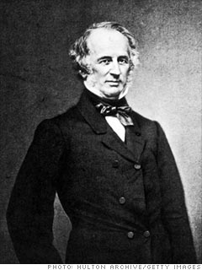
Railroads For Profit
Robber Barons
Goal was to eliminate competition and create a monopoly (total control of an industry)
Jay Gould
Purchases the Union Pacific Railroad
Bought up smaller railroads and gained control of the railway west of the Mississippi River
Cornelius Vanderbilt
Gained control of all railroad lines leading into New York and Chicago

Slide 10
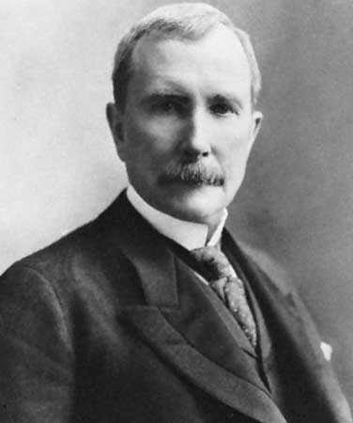
Railroads for Profit.
Robber Barons
Andrew Carnegie
Owner of Carnegie Steel
Vertical Integration
Every stage of a company’s production is controlled by one company
John D. Rockefeller
Owner of Standard Oil Trust
First Trust
When control of a company’s stock is put under a board of trustees

Slide 11
Bankers and Stockbrokers
J.P. Morgan
Financed mergers that created General Electric, International Harvester, and US Steel

Slide 12
Economic Disparity
Hourly Wages
Most worked a ten hour day for $1- $1.50
Most worked six days a week
Accidents meant loss of employment
Growth of industrialism led to an increase in the disparity of income and living conditions between the industrialists and the wage earners
Industrialists live a lavish lifestyle
Time period referred to as the Gilded Age

Slide 13
Working Conditions
Labor Unions
Knights of Labor, American Federation of Labor, Congress of Industrial Organizations
Sought to improve unregulated working conditions
Conflicts
Conflicts between Unions and management leads to violence
Railroad Strike, Haymarket Square Riot, Homestead Steel Strike

Slide 14
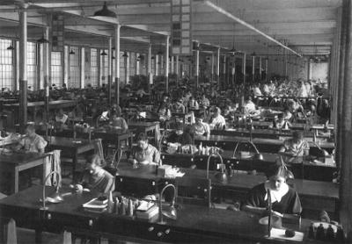
Working Conditions.
Laissez-faire
Government’s approach to labor unions, meant that the government did not interfere at all

Slide 15
Working Conditions..
George Pullman
Builds a plant and a company town outside of Chicago
Employees required to live in his town
Town equipped with churches and entertainment
Civil Liberties
Employees civil liberties limited
Not allowed to have independent newspapers, meetings, and houses subject to inspection
Wages decreased but rent stayed the same leading to a violent strike

Slide 16
Working Conditions…
Triangle Shirtwaist Company Fire
Sweatshop located in upper floors of a New York City building
Fire erupts
Workers panicked and fled to fire escape
Fire escape broke under the weight of the workers plunging workers to their death
Doors leading to stairwells were locked
Were locked so that women were not able to leave to take breaks
145 Workers die, most were women or children

Slide 17
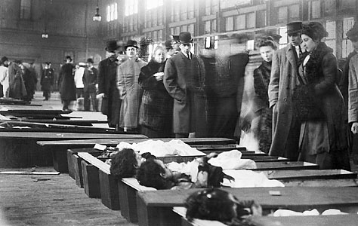
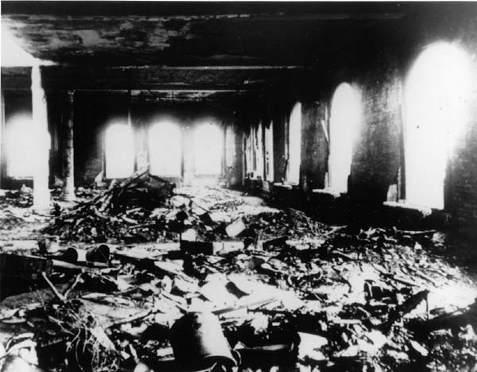

Slide 18
Technological Innovations
Railroad Sleeping Car
George Pullman
Air Brakes for trains and Railway signaling system
George Westinghouse
Telephone
Alexander graham Bell
Incandescent Light bulb
Thomas Edison

Slide 19
Technological Innovations.
DuPont
Supplied gunpowder during the Civil War
Develops dynamite and smokeless gunpowder

Slide 20
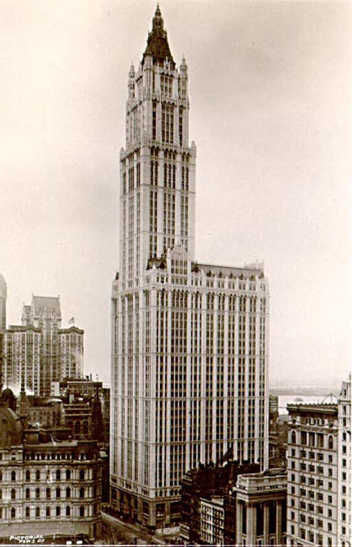
Technological Innovations..
Technological Innovations help people living in cities
Electric Streetcar
Automobile
Skyscraper
Followed invention of elevator and a new method of building with steel beams
Woolworth Building
Chrysler Building

Slide 21
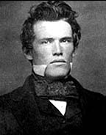
Processed Foods
Originally used during war to feed soldiers
Food was treated, canned, and mass produced
Milton S. Hershey
Mass produced milk chocolate
Gustavus Franklin Swift
Pioneer in meat-packing and refrigeration
Made beef cheaper and easily transported
Philip Armour
Dominated the meat-packing industry and developed a large fleet of refrigeration cars

Slide 22
Middle Class
Improved standard of living for the middle class
The industrial revolution leads to a growing middle class in the United States

